Slide 1
RF Cable connection
Digital/Data I/O
Script input control
Radio Frequency Network (RFN) (Attenuation)
(Delay)
RF Recording
Laptop
LoRa Radio
LoRa Radio
Signal Analysis
Jammer
Results (Range Ratio)
(ROC Curve)
(Slash Curve)
(Throughput vs Range)
(Anomalies)
CAF Analysis
4 port RF recorder
Results
(Geolocation)

Slide 2
Primary Heltec Dev Board
Laptop
Onboard LoRa chip & Transceiver
Onboard Microprocessor
Data Capture
USB Serial
Test Application
RFN
Remote Heltec Dev Board
Onboard LoRa chip & Transceiver
Onboard Microprocessor
Test Application

Slide 3
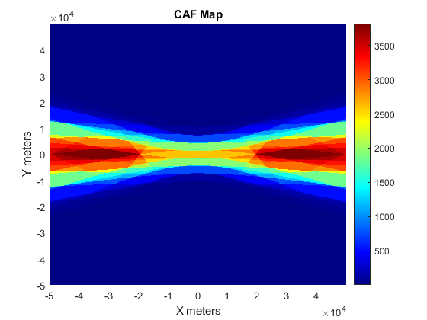
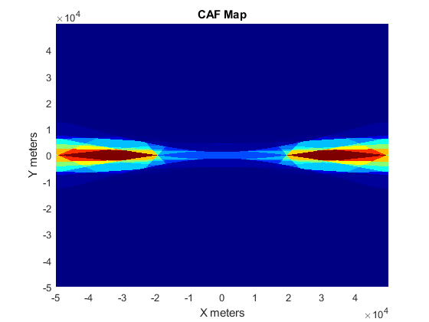
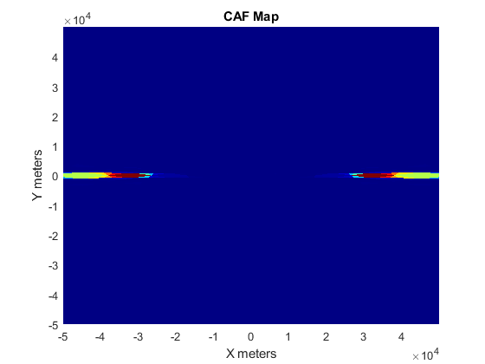
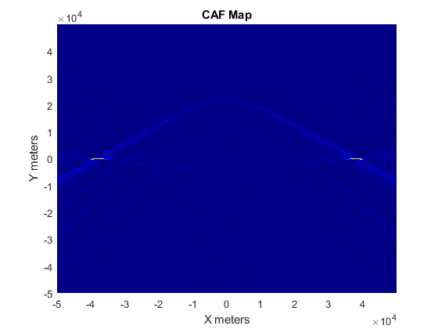
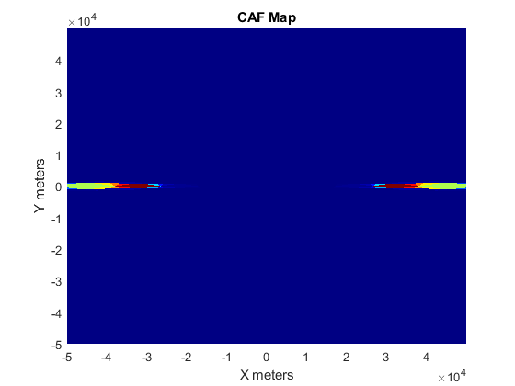
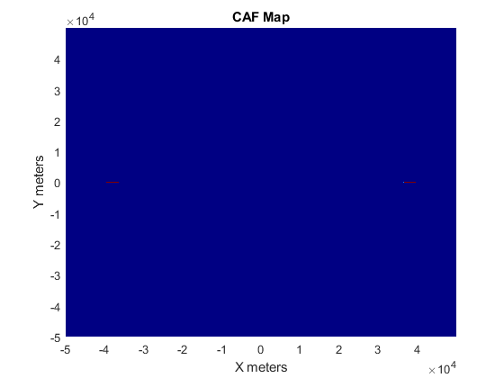
CAF
Top SF 7
(Left-right) BW 10.4k, BW 20k, BW 125k, BW 500k
Bottom SF 12
(Left-right) BW 125k, BW 500k
Bandwidth has much greater effect
Narrow BW is more difficult to pinpoint via TDoA/FDoA

Slide 4
4 capture points used with 6 cumulative CAF calculations
Wider BW is known to be easier to geolocate and correlation peaks are sharper from CAF.
TDoA precision from wide BW
FDoA
Multipath would make narrow band more blurred?
Doppler would decrease Fdoa presicion
LoRa has enough range of BW choices to have varying effect?
Need to calculate area of peaks for comparison analysis

Slide 5
Scenarios Used
CAF
Range and Jamming (dynamic scripts and movement)
X nm
60 nm
10nm
2 nm increments
SF 7 10.4k
X = 400nm
SF 7 20k
X = 480nm
SF 7 125k
X = 390nm
SF 7 500k
X = 160nm
SF 12 125k
X = 500nm
SF 12 500k
X = 480nm
20nm
10nm
10nm
Transceiver moves forward 60nm @ 2nm increments with and without jammer present at the endpoint.
Compares impact of comms with and without jammer to compare breakpoint and falloff deltas
Jammer emulated was commercial (and legally obtained) USRP X104 SDR with 23dBm output power.
10nm

Slide 6
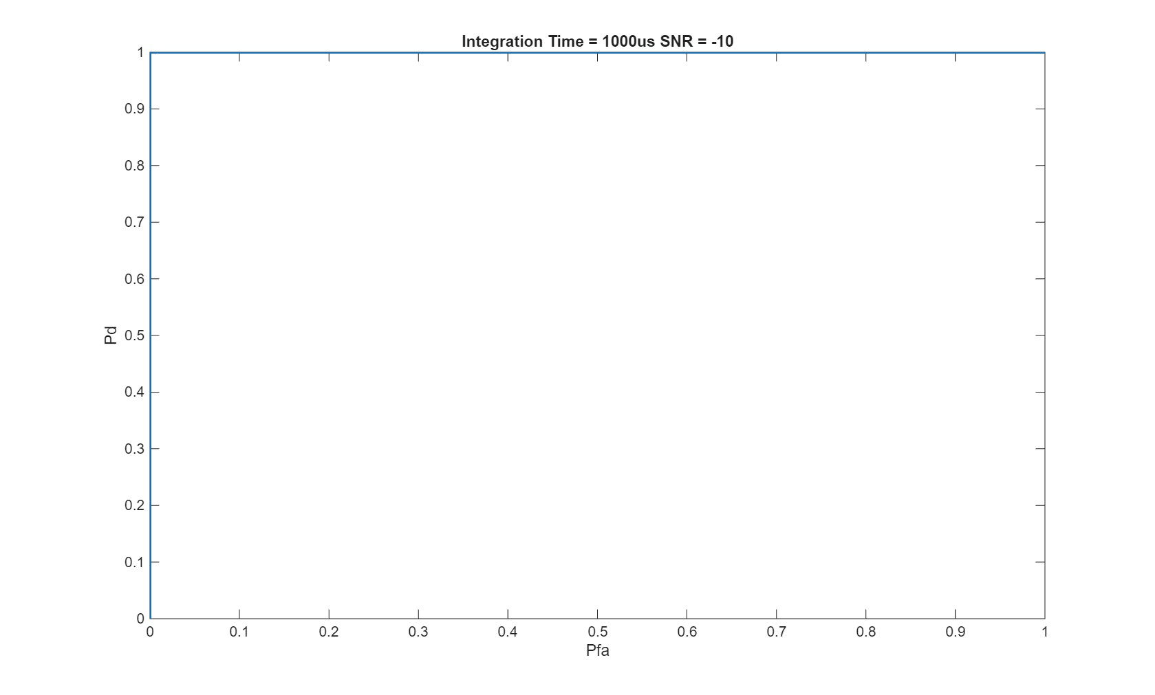
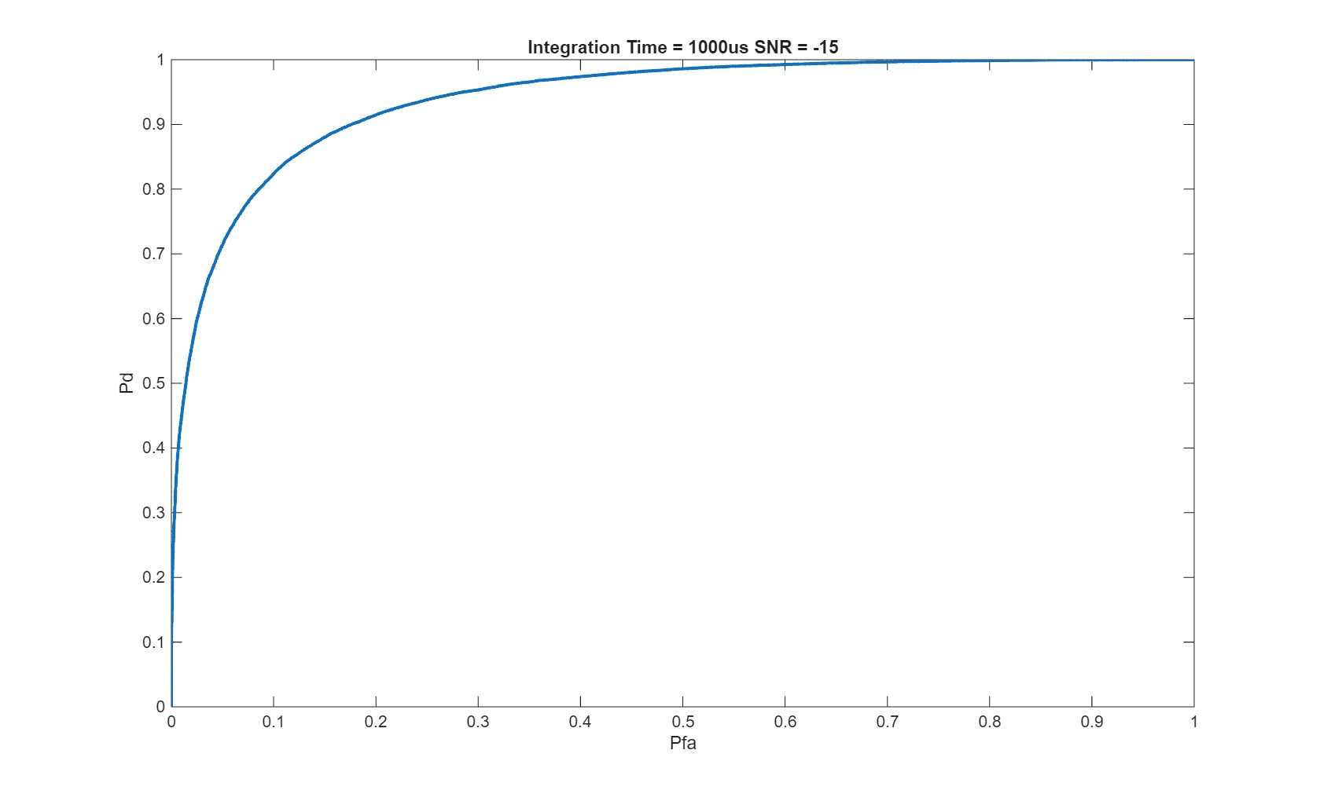
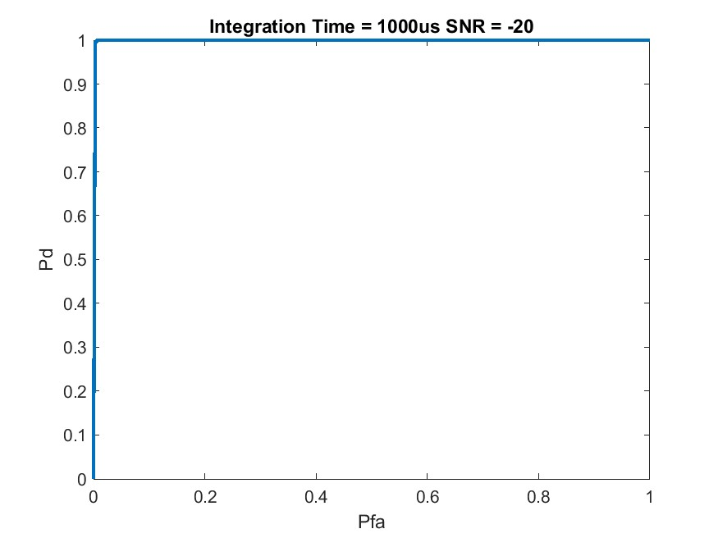
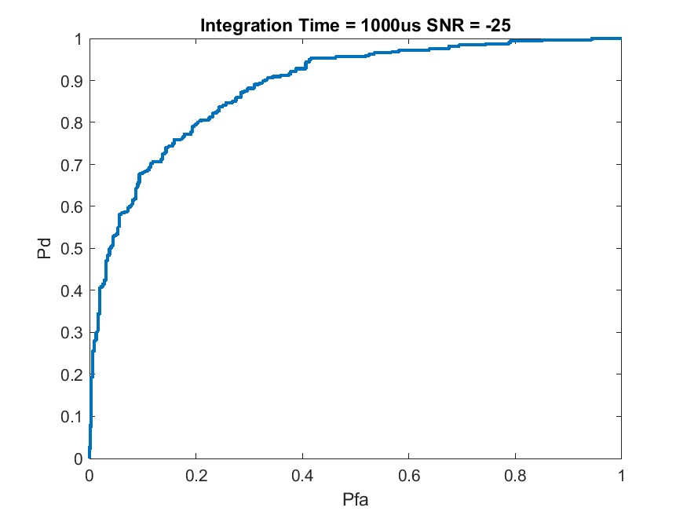
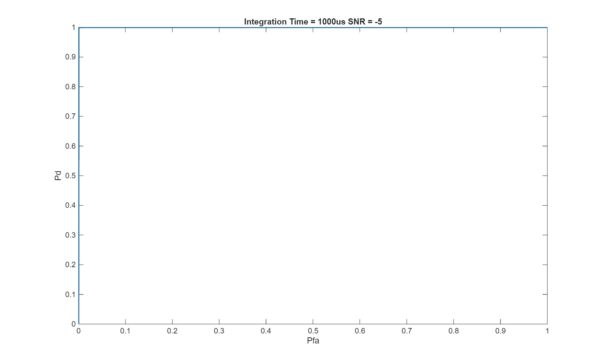

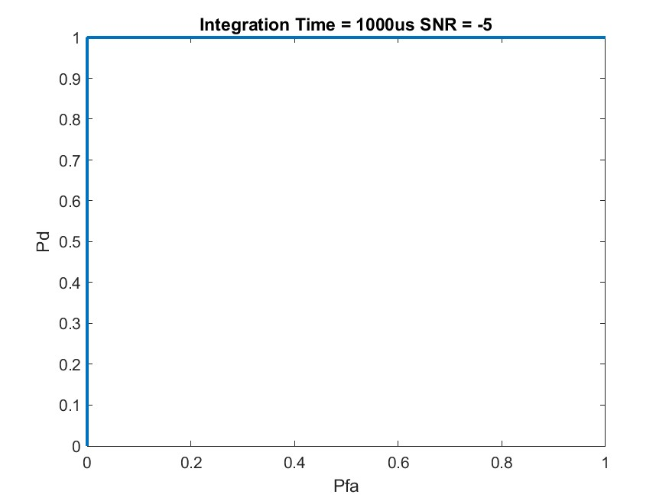
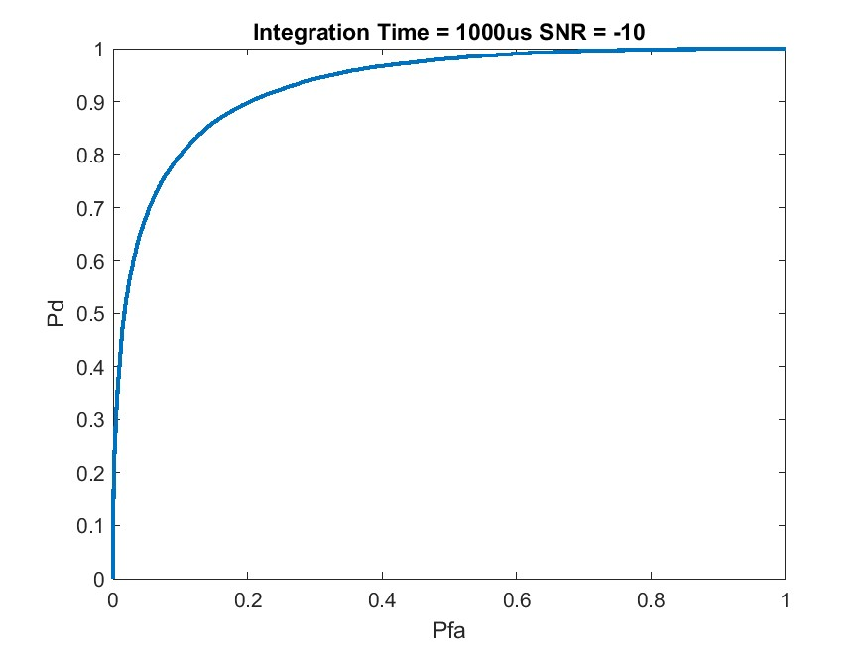
SF 7 10.4
Comparison WF
-10 SNR
-15 SNR
-20 SNR
-25 SNR
SF 7 500k
SF 12 500k
-5 SNR
-10 SNR
-5 SNR
-10 SNR

Slide 7
SF 7 10.4
Independent of wf’s capability to operate at these SNRs
What kind of SNRs can LoRa operate at with various configs and compare to these results
-10 SNR
-15 SNR
SF 7 500k
-5 SNR
-10 SNR

